Slide 1
P

Slide 2
Practice Respect and Kindness

Slide 3
A

Slide 4
Act Responsibly

Slide 5
w

Slide 6
Work Hard

Slide 7
s

Slide 8
Stay Safe

Slide 9
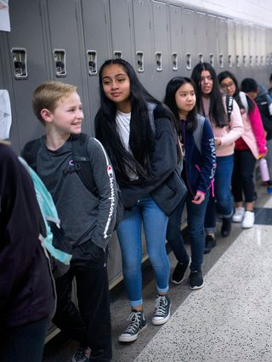
PAWS: Hallway & Lockers
Keep hands & feet to self
Positive language
Appropriate volume
Be efficient with your time
Use your locker only
Keep your locker combination to yourself

Slide 10
PAWS: Hallway & Lockers
Plan ahead? What do I need today?
Directly report to room/area
Keep hallway clear and keep locker closed/locked
Stay to the right when traveling in hallway and stairwells
Report unsafe conditions to BMS office

Slide 11
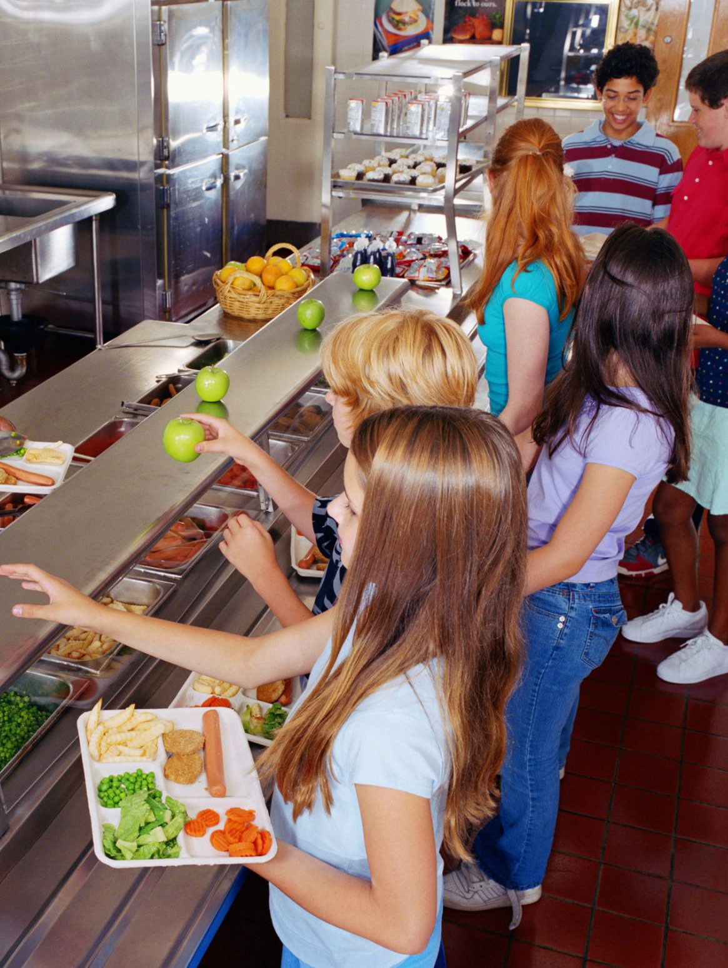
PAWS: Cafeteria
Keep hands and feet to self
Positive language
Use manners
Use time wisely
Get your food/supplies on one trip
Clean up after yourself

Slide 12
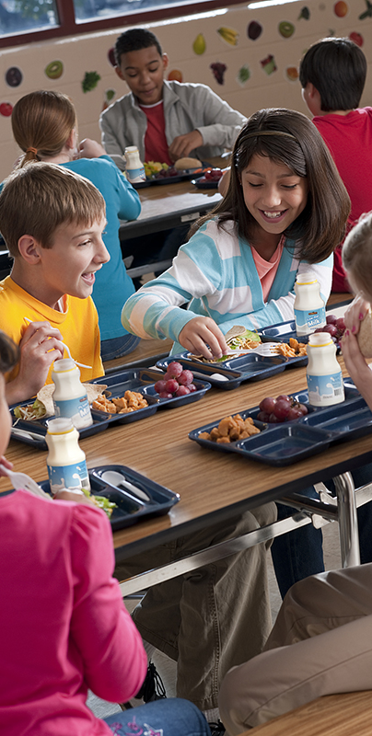
PAWS: Cafeteria
Ask adult for permission to leave cafeteria
Know your lunch number
Walk
Stay in your seat
Listen to adult(s) for instructions
Chew your food
Report unsafe conditions to an adult

Slide 13
PAWS: Classrooms
Keep hands & feet to self
Positive language
Know the classroom rules/ expectations
Be prepared/have the supplies you need
Be attentive/willing to learn
Be helpful
Accept acknowledgement & consequences for your actions

Slide 14
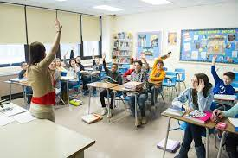
PAWS: Classrooms
Have a future plan
Complete your own work
Strive for excellence
Watch out for people around me
Walk
Keep materials out of the aisles
Be aware of Fire drill & Emergency procedures

Slide 15
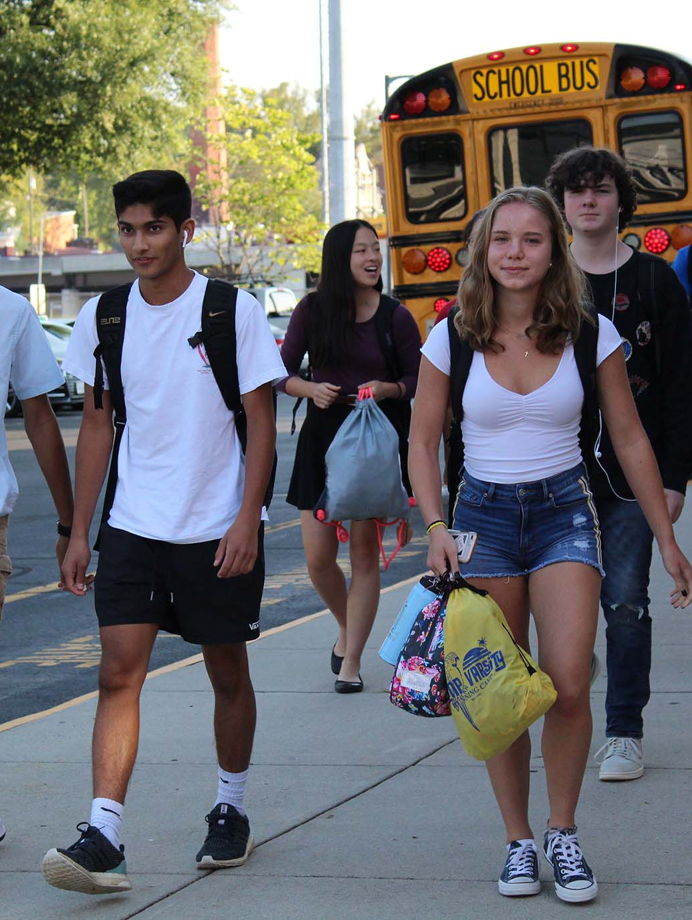
PAWS: Arrival/Dismissal
Keep hands & feet to self
Positive language
Remove all headware/ear phones/etc…
Use courtesy/hold doors
Head directly to your destination/area
Attend school daily and on time
Accept acknowledgement & consequences for your actions

Slide 16
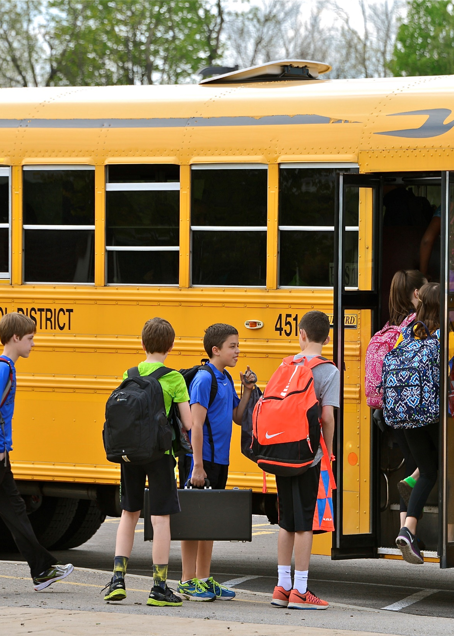
PAWS: Arrival/Dismissal
Use time wisely (homework help/positive peer interactions)
Listen for teacher/adult instructions/announcements
Be aware of your surroundings
Receive permission to leave designated area
Walk – do not run
Report unsafe conditions to a staff member

Slide 17
PAWS: Bathroom
Give people their privacy/one person per stall
Personal space – keep hands and feet to self
Keep restroom clean
Flush toilets
Wash your hands
Turn off faucet
Accept acknowledgement & consequences for your actions

Slide 18
PAWS: Bathroom
Limit time spent in the restroom
Do your business and go back to class/area
Don’t waste time
Follow sign out procedures to use the restroom
One person per sink/toilet
Report unsafe conditions to a staff member

Slide 19
PAWS: Transportation
Use positive & encouraging language
Personal space/keep hands and feet to yourself
Use manners
Do not litter
Stay off of/away from community property

Slide 20
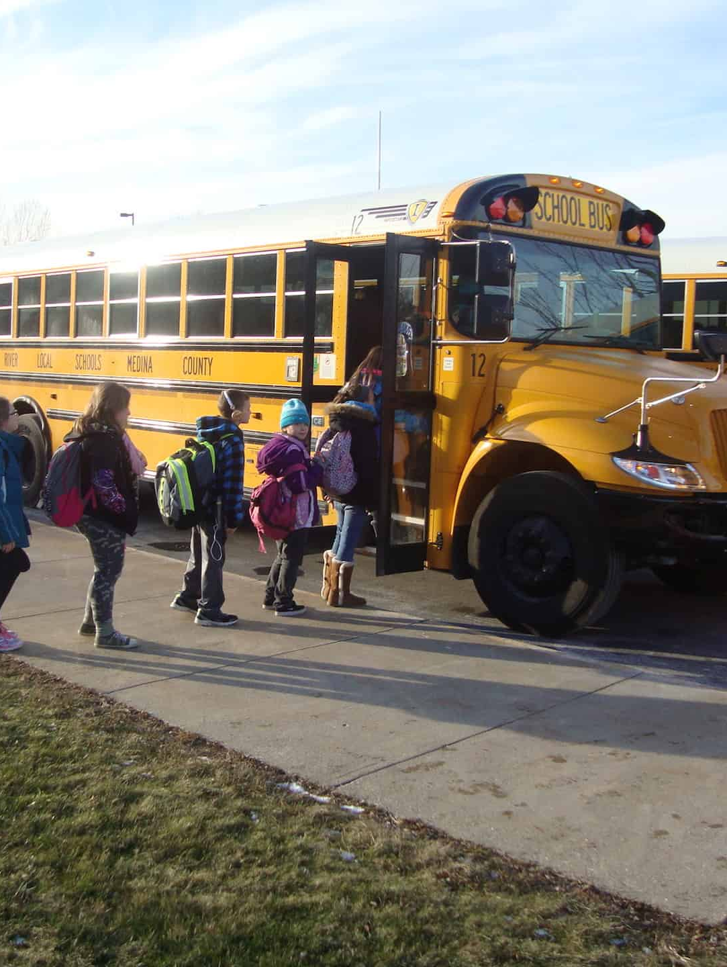
PAWS: Transportation
Be on time/adhere to transportation schedule
Go directly to your vehicle
Talk quietly/don’t distract the driver
Arrive & depart at designated times
Accept acknowledgement and consequences for your actions
Use time wisely

Slide 21
PAWS: Transportation
Listen for adult instructions/ announcements
Follow traffic laws/use crosswalks & sidewalks
Report unsafe conditions to a staff member
Stay in your seat while riding the bus/van
When available, use a seatbelt
Do not distract the driver

Slide 22
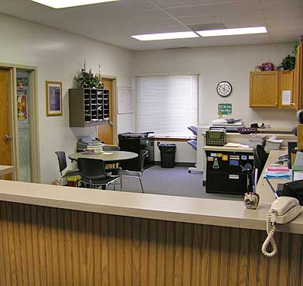
PAWS: Office Areas
Personal space/keep hands & feet to self
Positive/encouraging language
Use a quiet voice
Be polite
Wait patiently

Slide 23
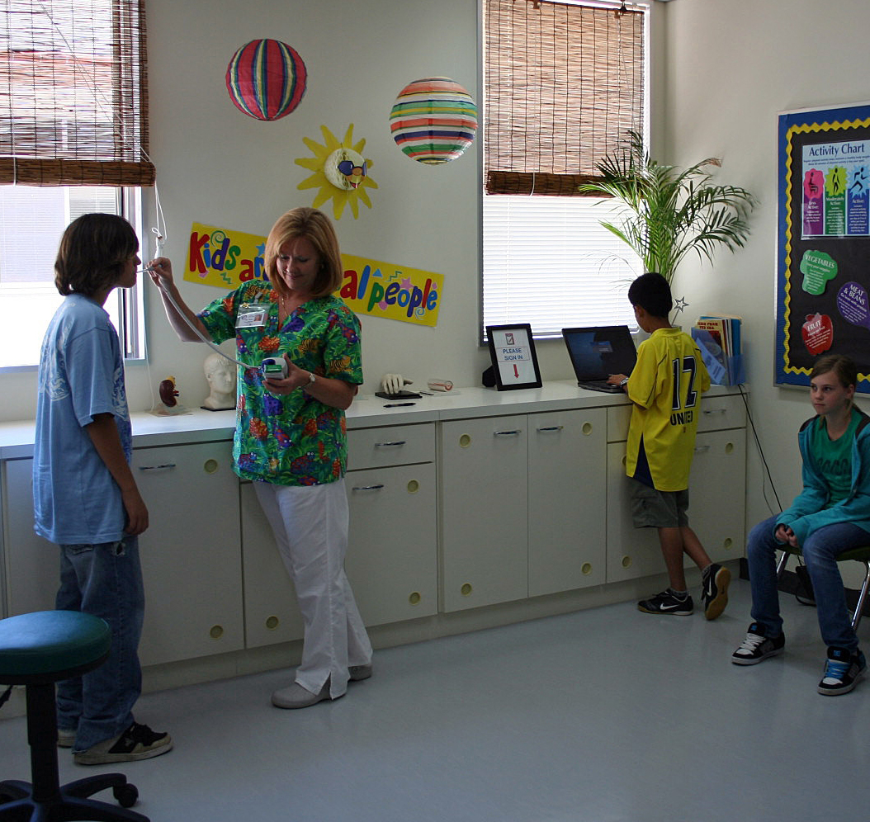
PAWS: Office Areas
Know & articulate the reason for your visit
Accept acknowledgement & consequences for your actions
Listen for & follow adult instructions
Respectfully report emergencies
Stay clear of entrances/ exits

Slide 24
PAWS: Use of Technology
Use for school related activities only
Use when directed
THINK before you post
Keep it charged
Store in provided computer bag
Keep your own charger
Use your own device at all times
Stay on safe, teacher approved websites
Reply to sender (not Reply all)

Slide 25
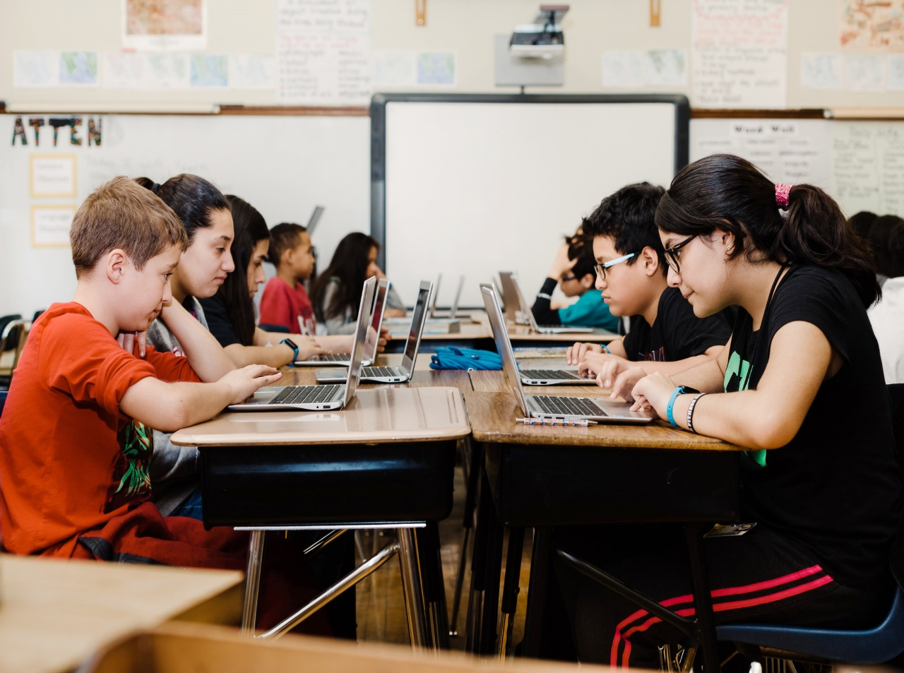
PAWS: Use of Technology
Report misuse to an adult
Bring laptop & charger to school & home
Be aware of your time & purpose on social media
Be careful – laptops are fragile
Do not share personal information or usernames/ passwords

